Slide 1
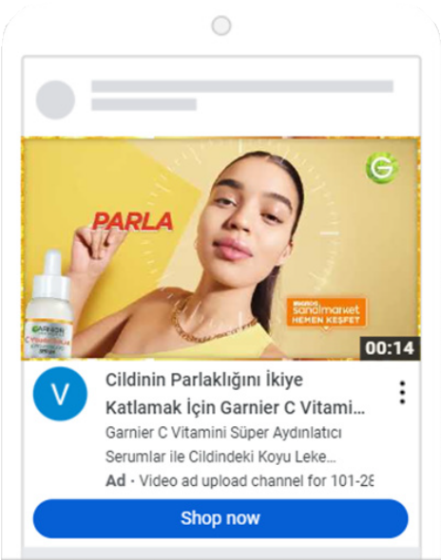
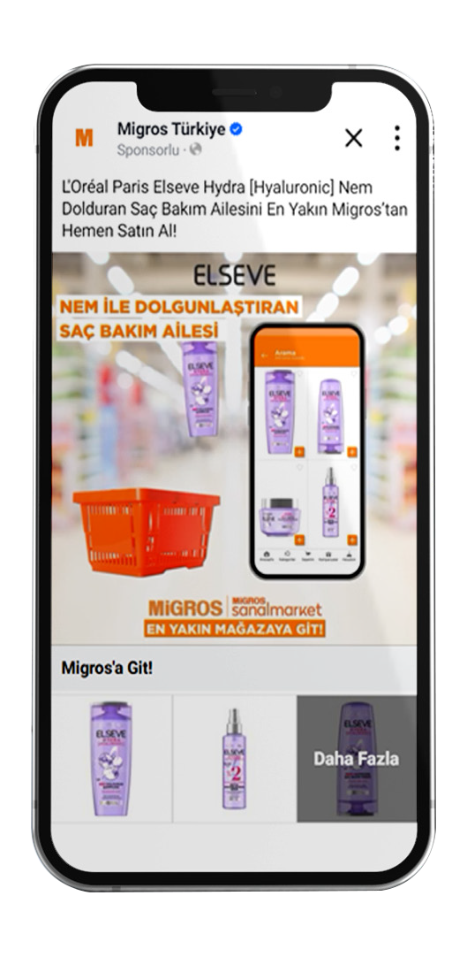
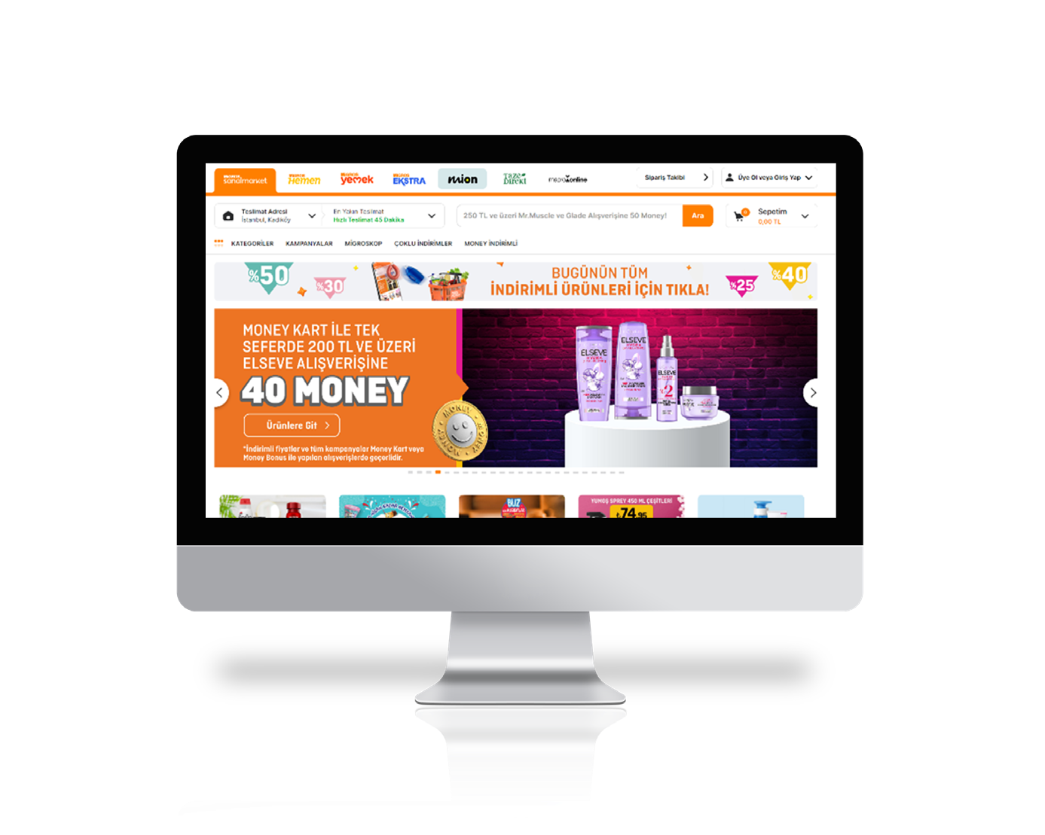
Case Study
DIGITAL 360 CAMPAIGN:
Mimeda & L’Oreal collaborated, ensuring L’Oreal reachs the right target audience on the right platforms to maximize its sales and brand awareness.
The communications were woven through two different branches: in Migros Online and Off-site Digital channels.
Campaign Dates
January 2024 – February 2024
Target Customers
Money Loyalty Program clients that were analyzed and segmented into potential L’Oreal customers.
Channels
Migros Online, Digital Circular, Social Media Platforms, Google Coop
STRATEGY
Mimeda ensured that L'Oreal stands out in our advertising spaces in Migros Online. Through Display Banner, Sponsored Brand, and Sponsored Product (Search Ads) advertisements, customer interaction with L'Oreal products were facilitated. In the digital channesl, we effectively targeted Money audiences speciﬁcally prepared for L'Oreal in TikTok, Meta, and Google Coop advertisements
RESULTS:
Digital channels:
74 million impressions & 554k clicks
+140% online sales & +52% offline sales
Migros Online:
3x ROAS with 4.6 million impressions.
+80 M +%140
IMPRESSIONS ONLINE SALES
RESULTS
+%52
OFFLINE SALES

